Slide 1

ART BUZZ - WORLD
GLOBAL ART & DATA BOOTCAMP

Slide 2
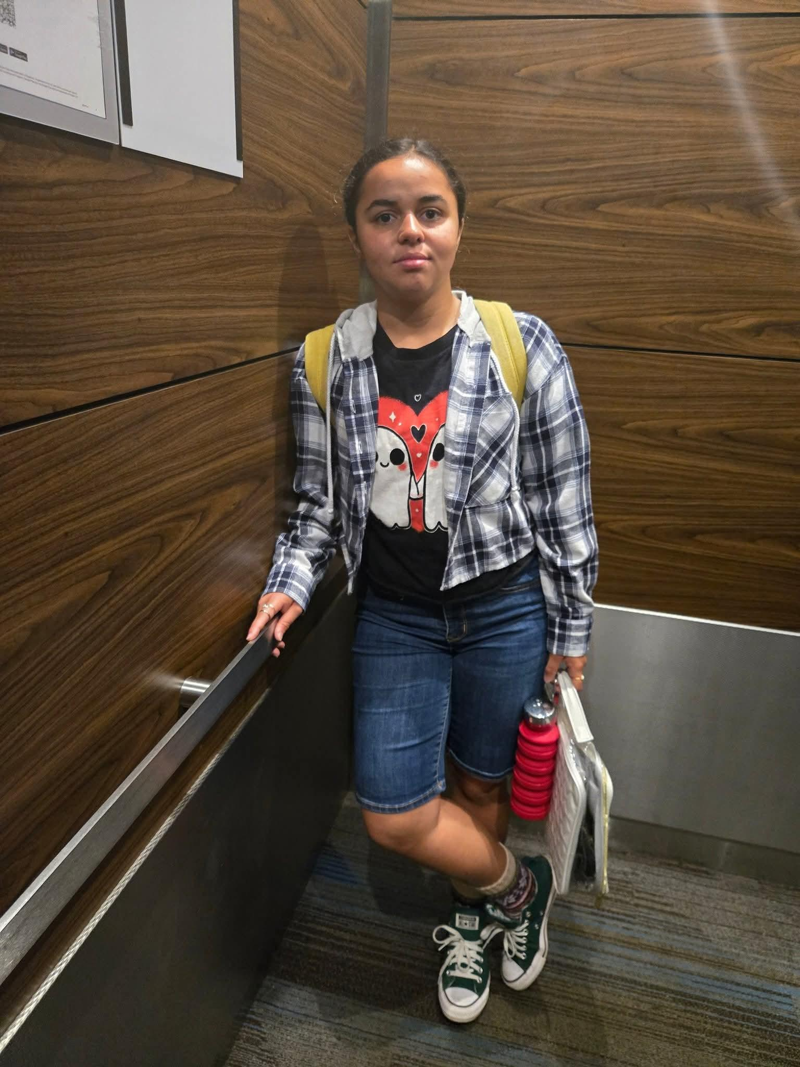
Rainbow MOSHO: The Vibrant Force of Young Creativity
A picture of Rainbow MOSHO
Teen artist and author on the Autism spectrum.

Slide 3
Interview by ART BUZZ - WORLD
Her works have already begun to capture attention both locally and internationally. Teachers, collectors, and fellow creatives describe her art as “raw yet refined,” a reflection of both innocence and wisdom. What makes Rainbow MOSHO stand out is not just her technical skill but the honesty that radiates from each piece.
During the interview, she revealed that her dream is to inspire other young people to embrace creativity without fear.
“You don’t have to wait to be ‘grown-up’ to be an artist. Your voice matters now,” she explained passionately.
The ART BUZZ – WORLD team left the conversation convinced that Rainbow MOSHO represents the next wave of youthful artistry. She is proof that art is not bound by age but fueled by vision, courage, and heart.
As she continues to develop her craft, one thing is certain: Rainbow MOSHO is not just painting pictures—she is painting a future full of color, hope, and imagination.
In the ever-expanding universe of art, few names shine as uniquely as Rainbow MOSHO. Recently, ART BUZZ – WORLD magazine had the privilege of sitting down with this remarkable young artist whose work is as bold and colorful as her name suggests.
Rainbow MOSHO is more than just an artist—she is a storyteller. Through her vivid paintings, drawings, and mixed media experiments, she channels emotions and perspectives far beyond her years. Her creations often weave together themes of imagination, empowerment, and self-expression, all infused with her signature fearless use of color.
When asked what drives her artistic journey, Rainbow MOSHO told ART BUZZ – WORLD:
“Art is my way of showing the world what I feel inside. It’s not just about colors on a page—it’s about speaking without words.”

Slide 4
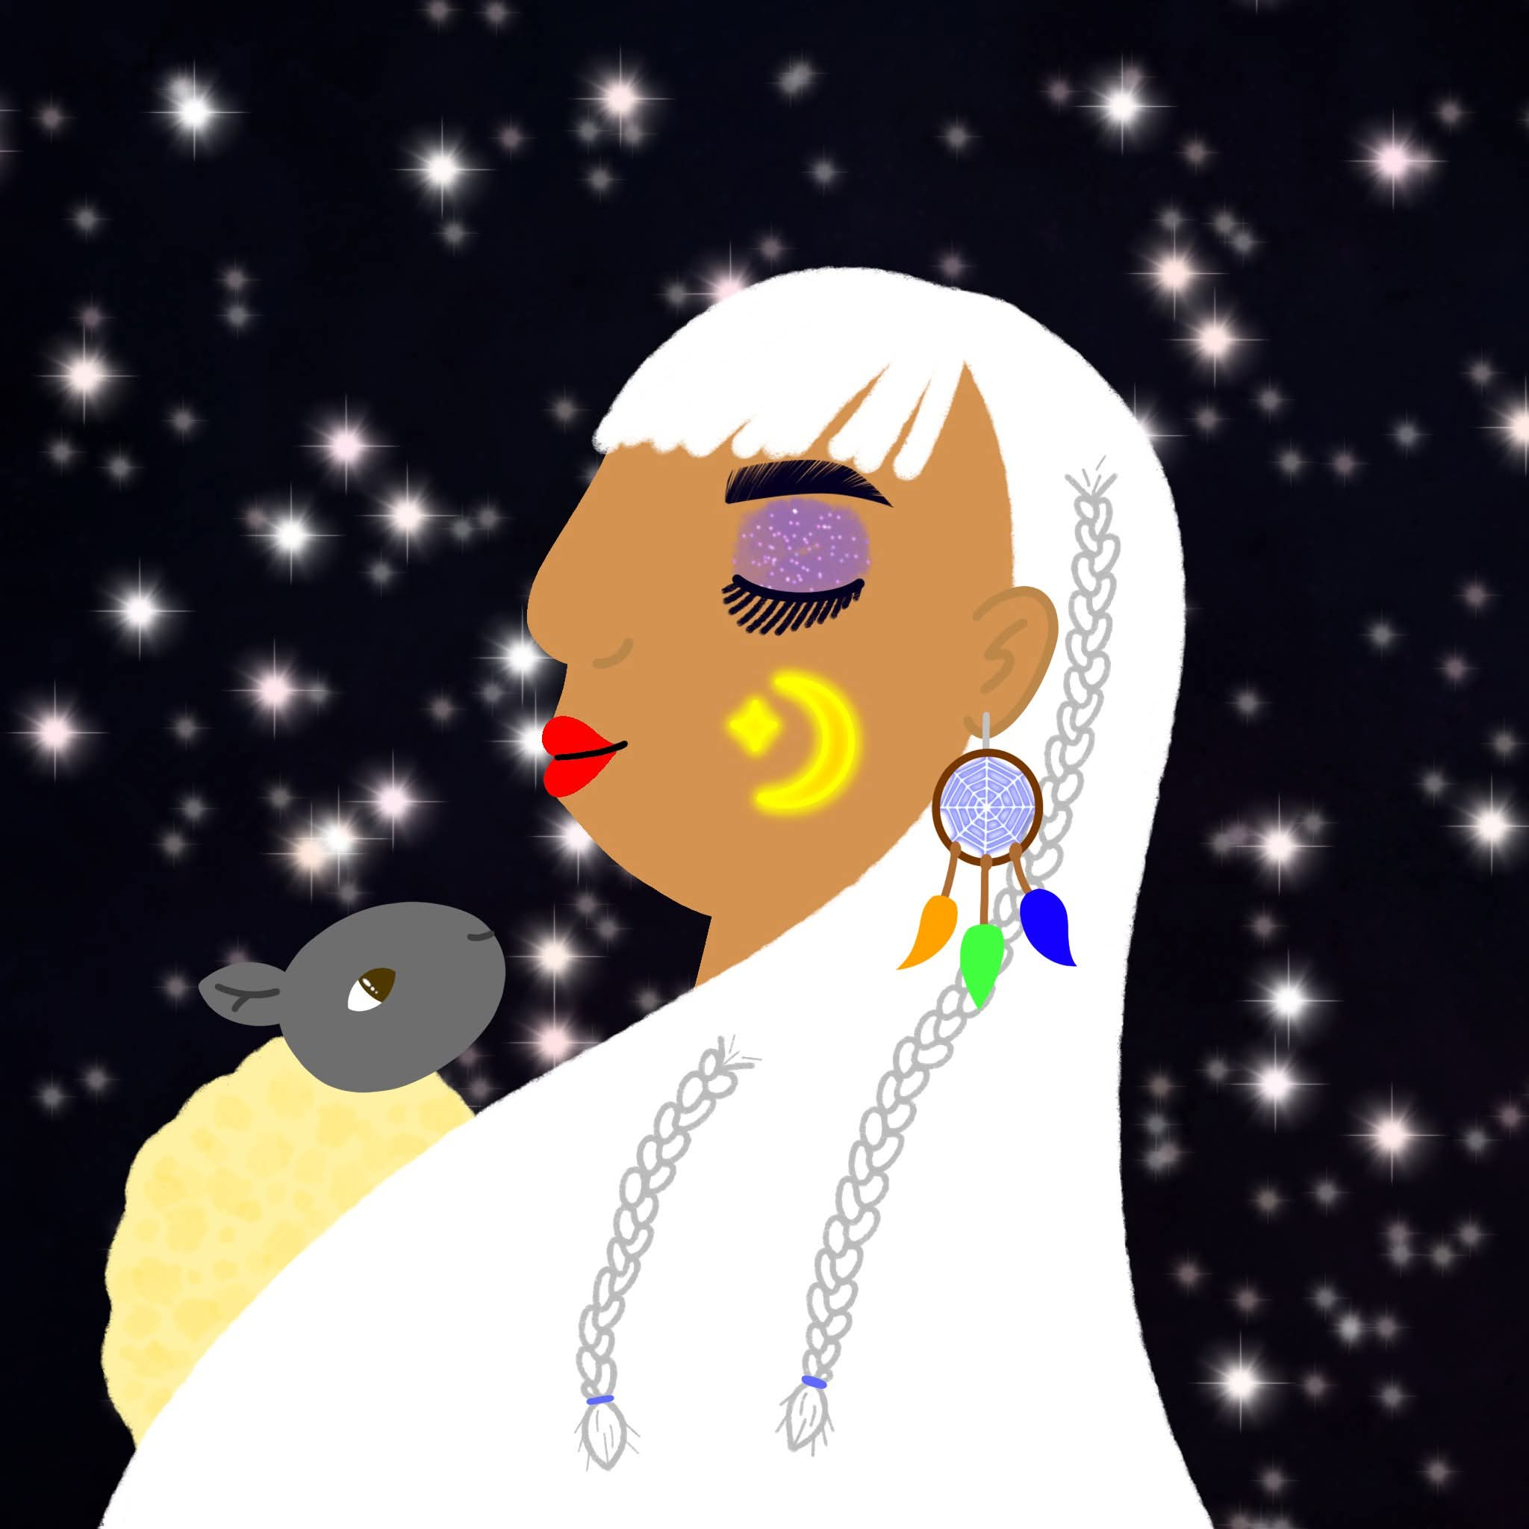
One of her artworks:
“When I create, I feel powerful.
When people respond to my work, I feel like I matter.
That’s the gift that has been given to me—and I give it back every time I put brush to canvas, words to page, or voice to stage.”
_ Rainbow MOSHO

Slide 5

Art Buzz - World
Joe Adix’s vision for Kenya's next generation of artists …
The Joe Adix's artistic organization's logo

Slide 6
When Kenyan artist Joe Adix dreamed up Art Buzz World in 2022, his goal was simple: to give young creatives the kind of opportunities he never had. On September 1, 2025, that dream officially came alive with the organization’s launch—a milestone that blends art, education, and community in one bold initiative.
Art Buzz World is not just another arts program. Its mission is to nurture young rappers, sketch artists, and writers, while also educating communities about Autism Spectrum Disorder (ASD). At weddings, school ceremonies, and family gatherings, parents will now find themselves invited to short lecture-style sessions—just an hour or two—where Adix personally shares insights on Autism, making the information accessible and practical. His blog and magazine extend this learning beyond events, offering ongoing guidance for parents.
But Adix’s vision doesn’t stop there. Young participants will be welcomed into the group’s Slack community, a digital home where they can collaborate with professional artists, rappers, and writers. Alongside mentorship, they’ll also learn Mathematics and Programming, building skills to create apps, produce music, design art, and write with impact.
“This is about preparing a new kind of artist,” Adix explains. “One who can sketch, rap, write—and also code, innovate, and lead.”
As a non-profit, Art Buzz World is calling for volunteers to help expand its reach, with government registration already in progress. To celebrate the creativity within its community, the organization will also publish an annual magazine, ART BUZZ – WORLD, showcasing stories, artworks, and achievements of its members.
For Adix, the launch of Art Buzz World is more than an organizational milestone—it’s the beginning of a movement. “Kenya’s next generation of artists deserves not just inspiration, but opportunity,” he says. “That’s what Art Buzz World is here to give.”

Slide 7
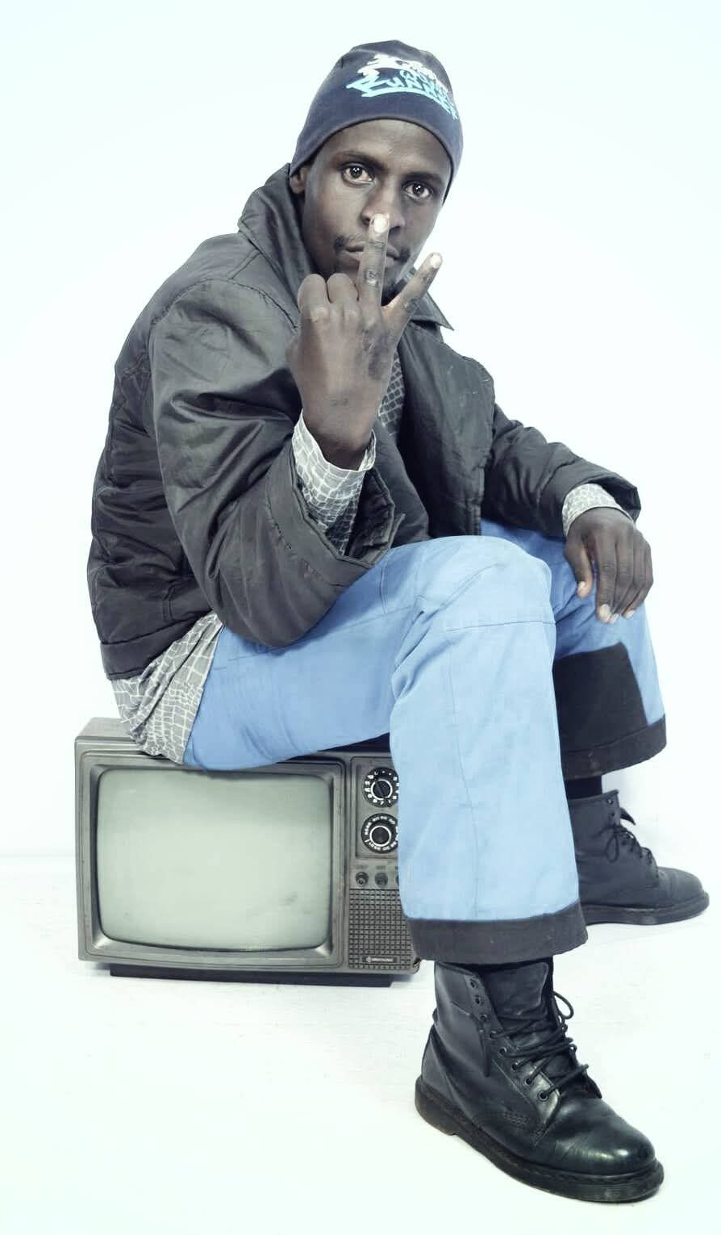
Rapper Joe Adix on Creating Art Without Conformity
A picture of the rapper: Joe Adix.
“With the Jehovah's Witnesses kind of thinking, mine is just a good artistic content that people do like!”

Slide 8
“Mine is just a good artistic content that people do like!"
That’s how Kenyan rapper Joe Adix describes his unique approach to music. For him, the art comes first—not the flashy studios, big record labels, or a massive social media following.
In a world where artists often feel pressured to chase fame, money, and recognition, Adix takes a different route. He believes that at the heart of music is the connection between content and people.
“On the ground, people just love content that entertains them. They don’t really care about all those things that attribute a rich and a famous artist,” he explains.
For Joe Adix, creativity thrives in simplicity. He doesn’t rely on expensive setups or industry gatekeepers. His method is direct: if he finds a beat he likes, he pours his energy into crafting something powerful out of it.
“You give me a beat, I like it, I then go ahead and create a great track on my own. I create a magic! I don’t need no materialistic things in order to entertain someone,” he adds with conviction.
This grounded philosophy sets him apart from mainstream rap culture. His work emphasizes authentic expression over polished packaging. Listeners gravitate toward his sound not because it’s backed by hype, but because it resonates with real human emotion.
Joe Adix is a reminder that music is not defined by what surrounds it—money, fame, or industry approval—but by the artistic essence that moves people. In his own words, he’s not chasing stardom, he’s creating magic for the people who truly listen.
By: ART BUZZ - WORLD

Slide 9
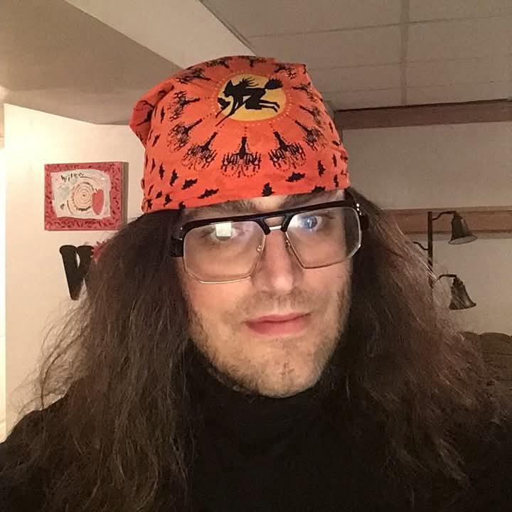
The Duke of Artz: Turning Autism into a Canvas of Creativity.
Inside the imaginative world of Joshua Hartzler, the artist who sketches beyond boundaries.

Slide 10
By ART BUZZ – WORLD | The Artist’s Palette
When Joshua Hartzler, also known as “The Duke of Artz”, sits down with his pencils and sketchpads, he’s not just drawing lines. He’s weaving worlds.
In an exclusive interview with ART BUZZ – WORLD lifestyle magazine, Joshua opened up about art, autism, and the dreams that fuel his creativity.
“Living with autism shapes how I experience life,” he says. “Sometimes I talk to myself or quote movies. Sometimes I get anxious. But art helps me transform those moments into something beautiful.”
Joshua is a self-taught, mixed-media sketch artist whose subjects are as diverse as his imagination:
- Power Rangers
- Dinosaurs
- Celebrities
- Halloween monsters
- Fairy tale creatures
- Landscapes and abstracts
“Anything that allows me to showcase my talents and bring joy to others—I’ll draw it,” Joshua explains.

Slide 11
Stories that Breathe | The Digital Canvas
Joshua’s creativity doesn’t stop at the page. He’s also a writer, blending fantasy, adventure, sci-fi, and horror into original tales—often paired with his own illustrations.
“I love acting out scenes, practicing dialogue, and researching characters. My art and my stories go hand in hand,” he says.
His inspirations include R.L. Stine, Betsy Haynes, and Stephen King, names that echo in the spine-tingling edges of his fiction.
Far from hidden in sketchbooks, Joshua’s work reaches fans across platforms:
YouTube – Creative Endeavors
Where slideshow videos showcase his illustrations set to music.
Facebook – Duke of Artz
A space where he shares art, self-expression, and what it means to live—and create—with autism.

Slide 12
Big Dreams Ahead | ART BUZZ – WORLD SIDE NOTE
Looking forward, Joshua hopes to collaborate with major film and animation companies:
DreamWorks
Disney
Cartoon Network
Warner Bros.
20th Century Fox
“I hope people enjoy my artwork as much as I enjoy creating it,” Joshua says, smiling. “Art is my way of expressing autism, imagination, and joy to the world.”
Why “The Duke of Artz”?
Joshua explains that the name came from his desire to stand out. “I wanted an identity that made me sound like I belong to the world of creativity. Something memorable, something noble—so I became The Duke of Artz.”
---
Follow The Duke of Artz on YouTube and Facebook to explore more of his sketches, stories, and creative journeys.
---

Slide 13


Slide 14
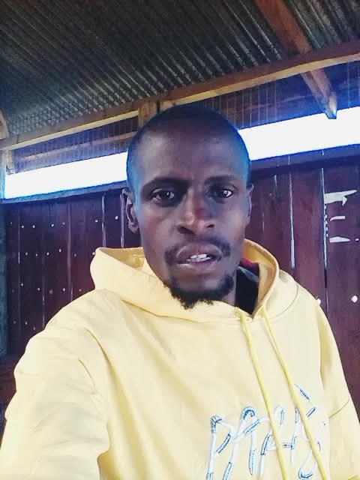
Leave the Prophet Alone! Adix Tells Creators
Educator and sketch artist: Joe Adix.
“It is wrong to twist information just so that you can get likes!”

Slide 15
On September 8, 2025, respected sketch-artist and educator Joe Adix unveiled Art: The Healing Anointing!!—a vivid, faith-driven depiction of Prophet Dr. David Owour, heralding a “great revival” in Kenya and the very presence of “the healing anointing of the Lord” to unite humanity under “God’s standards of morality”
But Adix’s message extends far beyond the canvas. In a forceful call to creators everywhere, he condemned a growing trend on social media—one in which influencers and content creators deride religious leaders, manipulating narratives to chase clicks and likes. He named the purge of honest belief by online cynicism a dangerous distortion of faith, pointing to instances where commentary about “the August 2 issue associated with Prophet Owour” had spread misleading distortions among audiences. These “critic-content” creators, Adix argues, not only sow confusion but also exploit religion for fleeting engagement.
At the heart of his criticism lies a profound affirmation of faith. Adix emphasized his conviction that spiritual followers—particularly those devoted to Prophet Dr. Owour—benefit deeply from the divine teachings they uphold. He spoke with clarity.
“Maintaining God’s standards of morality and having the power to abhor outdated beliefs in one’s tribe might... A Christian should believe in the might of the community of Bible readers and not in the might of his/her tribe,” Joe Adix added.
In these words, Adix challenges societal complacency—citing tribalism and moral decay—and positions faith as a transformative force. The artist asserts that true spirituality empowers individuals to rise above traditional tribal loyalties, anchoring themselves instead in a broader, scripture-centered community that champions universal standards of decency and holiness.

Slide 16
His latest artwork, then, is far more than visual expression—it’s a call to spiritual revival, moral clarity, and media responsibility. Through his art and his voice, Joe Adix urges a return to sincerity in faith, condemns the weaponization of religious narratives for digital fame, and reaffirms the church not as a tribal refuge, but a community of enlightened believers united by scripture.
In the words of Adix himself: “It is wrong to twist information just so that you can get likes!” And in that charge lies a timely reminder—for creators, for believers, and for a world in need of integrity, compassion, and truth.
Opinion by: Joseph Gachau, ZION’S WATCHDOG

Slide 17
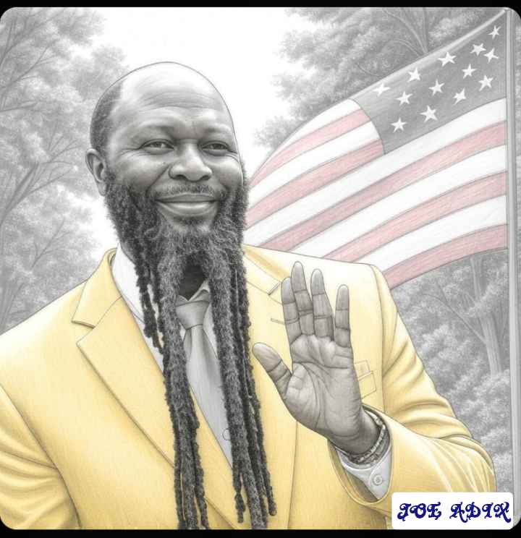
A bit about the artwork: The Healing Anointing!!
This evocative artwork portrays Prophet Dr. David Owour—who renounced his medical career in the 2000s—as a modern embodiment of Elijah’s spirit and power, heralding a sweeping revival in Kenya. The image is accompanied by a vivid proclamation: “A great revival has broken out in Kenya! … The healing anointing of the Lord is now here!!” Framed within the prophetic promise of Malachi 4:5-6, the piece invites viewers to consider that just as John the Baptist came in Elijah’s spirit to prepare for Christ’s first coming, Dr. Owour may likewise be raised for the second coming—urging repentance, holiness, unity, and moral renewal in both Kenya and the world.

Slide 18
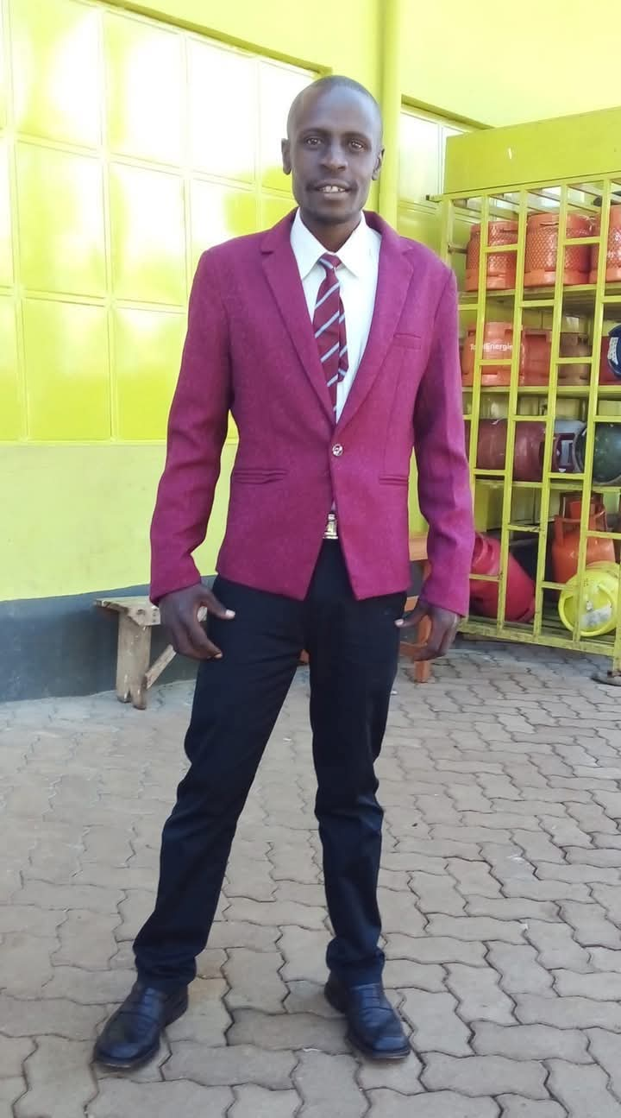
Is Adix Dropping Religion?
One of his after-Sunday-meeting photos.
Is Gachau really leaving the Jehovah’s organization?

Slide 19
Inside the World of Adix
A question has been stirring in both art and faith circles alike: Is the “Gyrokopta” artwork maker really stepping away from the Jehovah’s Witnesses faith?
When ART BUZZ - EARTH reached out to Joe Adix, he clarified the situation in his own words. While he no longer attends the weekly Sunday meetings, he emphasized that this does not mean he has left the faith. “For now, I’m simply committed to creating arts, writing, and teaching Math,” Adix explained. His energy has been channelled into his quarterly study magazine, Allistic Herald, which blends academic learning with his unique perspective on life.
Though he has stepped back from the Enjoy Life Forever! Bible study program, Adix continues to read his Bible privately and keep up with updates from the official Jehovah’s Witnesses website. Faith, for him, still holds significance. In fact, he shared plans to continue attending important annual events such as the Memorial of Jesus’ Death, circuit assemblies, and larger conventions.
Adix’s journey highlights a thoughtful balance—remaining spiritually connected while pursuing his creative and intellectual passions. The art world and faith community alike now watch with curiosity: Is this a temporary pause, or a new path altogether?

Slide 20
